Slide 1
docker

Slide 2
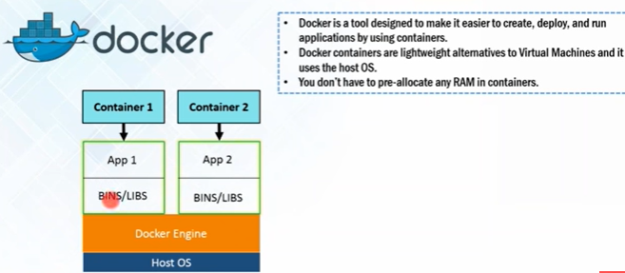
Docker : define
Docker is a tool that allows developers, sys-admins etc. to easily deploy their applications in a sandbox (called containers) to run on the host operating system i.e. Linux.
The key benefit of Docker is that it allows users to package an application with all of its dependencies into a standardized unit for software development.
Unlike virtual machines, containers do not have high overhead and hence enable more efficient usage of the underlying system and resources.
Docker is a tool designed to make it easier to create, deploy, and run applications by using containers.

Slide 3
VMs: define
The industry standard today is to use Virtual Machines (VMs) to run software applications.
VMs run applications inside a guest Operating System, which runs on virtual hardware powered by the server’s host OS.
VMs are great at providing full process isolation for applications: there are very few ways a problem in the host operating system can affect the software running in the guest operating system, and vice-versa.
But this isolation comes at great cost — the computational overhead spent virtualizing hardware for a guest OS to use is substantial.

Slide 4
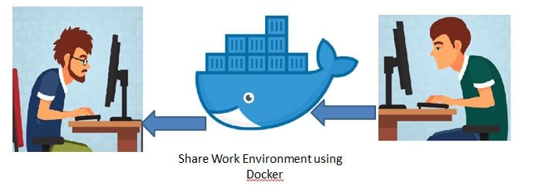
Containers : define
Containers allow a developer to package up an application with all of the parts it needs, such as libraries and other dependencies, and ship it all out as one package.
Create self-contained development environments inside Docker containers.
So we share an environment already configured.

Slide 5
Containers : requirements
Containers offer a logical packaging mechanism in which applications can be abstracted from the environment in which they actually run.
This decoupling allows container-based applications to be deployed easily and consistently, regardless of whether the target environment is a private data center, the public cloud, or even a developer’s personal laptop.
This gives developers the ability to create predictable environments that are isolated from the rest of the applications and can be run anywhere.

Slide 6
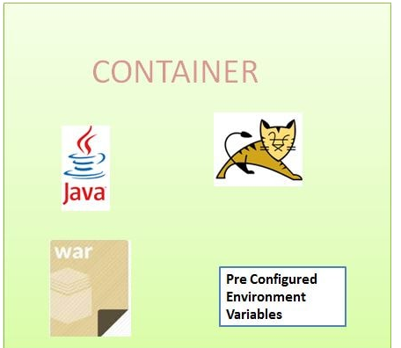
image : docker
An image is a lightweight, stand-alone, executable package that includes everything needed to run a piece of software, including the code, a runtime, libraries, environment variables, and config files.
So an existing fellow developer will create an image of his environment and share it with the new developer.
The new developer will just have to run the image as a docker container.

Slide 7
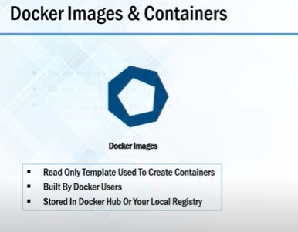
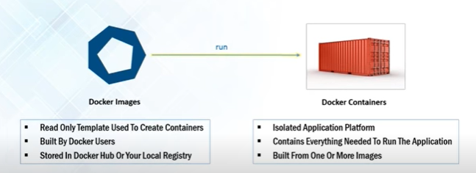
Image & Container : docker

Slide 8
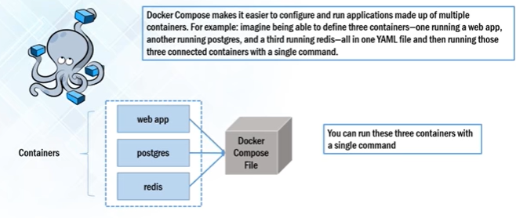
image : docker

Slide 9
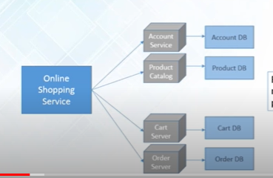
Docker : Case study

Slide 10
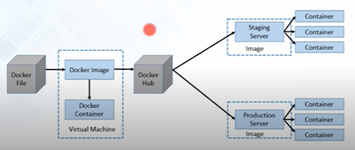

Docker : Case study

Slide 11
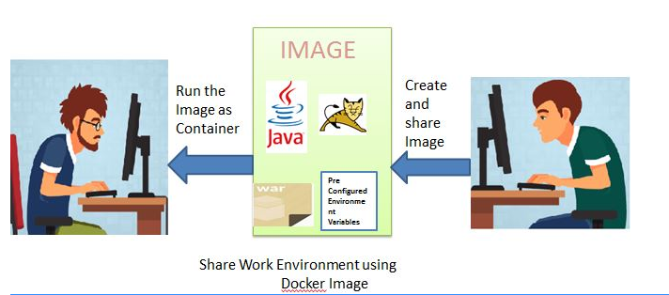
Case study: docker
A container is a runtime instance of an image what the image becomes in memory when actually executed.
It runs completely isolated from the host environment by default, only accessing host files and ports if configured to do so.

Slide 12
docker : commands
$ docker pull busybox
--pull command fetches the busybox image from the Docker registry and saves it to our system.
$ docker images
REPOSITORY TAG IMAGE ID CREATED VIRTUAL SIZE
busybox latest c51f86c28340 4 weeks ago 1.109 MB
--docker images command to see a list of all images on your system.
$ docker run busybox
--run a Docker container based on this image, To do that going to use the almighty docker run command.
$ docker run busybox echo "hello from busybox"
hello from busybox

Slide 13
docker : commands
$ docker ps
CONTAINER ID IMAGE COMMAND CREATED STATUS PORTS NAME
--The docker ps command shows you all containers that are currently running.
$ docker ps -a [ STATUS column shows .... ]
CONTAINER ID IMAGE COMMAND CREATED STATUS PORTS NAMES
305297d7a235 busybox "uptime" 11 minutes ago Exited (0) 11 minutes ago

Slide 14
Docker : key terms
Images - The blueprints of our application which form the basis of containers.
Like: Using docker pull command to download the busybox image.
Containers - Created from Docker images and run the actual application.
create a container using docker run which we did using the busybox image that we downloaded.
A list of running containers can be seen using the docker ps command.
Docker Daemon - The background service running on the host that manages building, running and distributing Docker containers.
The daemon is the process that runs in the operating system which clients talk to.
Docker Client - The command line tool that allows the user to interact with the daemon.
More generally, there can be other forms of clients too - such as Kitematic which provide a GUI to the users.
Docker Hub - A registry of Docker images.
think of the registry as a directory of all available Docker images.
If required, one can host their own Docker registries and can use them for pulling images.

Slide 15
Docker : components
The Docker open platform includes :
Docker Engine :
open source runtime that builds, runs and orchestrates containers
Docker Hub :
a hosted service where Dockerized applications are distributed, shared, and collaborated on by the entire development community or within the confines of a specific organization.
Docker containers :
enable developers to focus their efforts on application “content” by separating applications from the constraints of infrastructure.
Dockerized applications are instantly portable to any infrastructure – laptop, bare‑metal server, VM, or cloud – making them modular components that can be readily assembled and reassembled into fully featured distributed applications and continuously innovated on in real time.

Slide 16
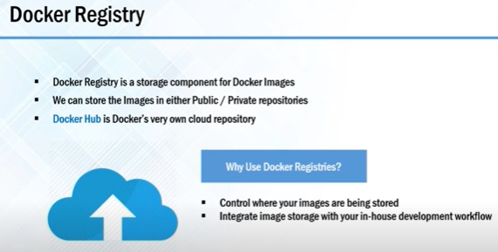
Docker : components

